Slide 1
Condition Variables
Chenglong Fu

Slide 2
Why we need condition variables
Thread determines its execution by whether a condition is true
Mutex requires frequent lock/unlock operations, always deadlock
Mutex don’t provide such condition check feature
Idle loop to check conditions
Producer can’t notify consumer about the condition change, vice versa
Condition variable provides better mechanism with block/signal structure
Condition variable doesn’t provides any mutual exclusion
Need to be used together with the mutex

Slide 3
Basic Operations of Condition Variables
int pthread_cond_init(pthread_cond_t *cond,pthread_condattr_t *cond_attr);
The initialized condition variable is unlocked, set cond_attr as NULL
int pthread_cond_wait(pthread_cond_t *cond,pthread_mutex_t *mutex);
Block the thread if cond locked, and unlock mutex at the same time
Once woken up by signal, relock the mutex at the same time
int pthread_cond_destroy(pthread_cond_t *cond);
int pthread_cond_signal(pthread_cond_t *cond);
Wake up one blocked thread, signal lost if no thread listening
int pthread_cond_broadcast(pthread_cond_t *cond);
Wake up all threads that are blocked

Slide 4
Usage Cases
Protected by the mutex
Check conditions in loop
Guarantee block
Signal after release of the mutex
The waked up thread need to regain mutex lock
For each C/P model you need:
One FIFO queue to contain the items
One mutex for both consumer and producer
Two condition variables:
Cond_consumer: used to block the consumer, check for whether the queue is empty
Cond_producer: used to block the producer, check for whether the queue is full

Slide 5
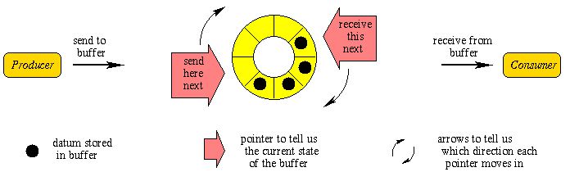
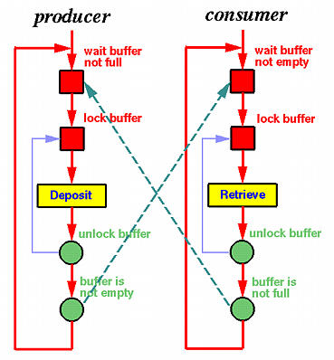
Used for Producer & Consumer Model
Consumer{
lock(mutex)
while(queue empty){
cond_wait(cv1,mutex)
}
/*remove from queue*/
unlock(mutex)
cond_signal(cv2,mutex)
}
Producer{
lock(mutex)
while(queue full){
cond_wait(cv2,mutex)
}
/*insert to queue*/
unlock(mutex)
cond_signal(cv1,mutex)
}

Slide 6
Important Notes
For Multi-thread programming:
Include <pthread.h>
append “–lpthread” args for gcc
You need 3 different types of thread:
Main thread: setup socket, accept connection and put it into job queue (1 thread)
Logger thread: open log file, write logs from log queue to log file (1 thread)
Worker thread: extract connection file descriptor from job queue, communicate with client through recv()/send(), do spellcheck (multiple thread)
You need 2 queue:
Job queue: contains connection fd, (producer: main, consumer: worker)
Log queue: contains log items , (producer: worker, consumer: logger)

Slide 7
